Slide 1
Circles
Parts of a Circle
Area & Circumference

Slide 2
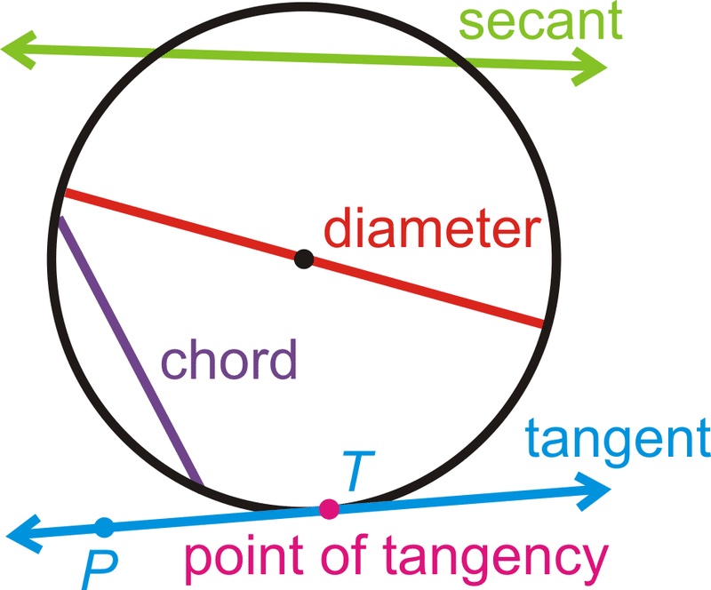
radius

Slide 3
RADIUS = ½ OF DIAMETER
If the radius is 5 cm, what is the diameter?
If the diameter is 32 ft, what is the radius?
10 cm
16 ft
58 cm
78 cm
What is the diameter?
What is the radius?
116 cm
39 cm

Slide 4
Circumference of a Circle
Formula is C = 2πr (2 x Pi x Radius)
or
C = πd (Pi x Diameter)
Remember…π = 3.14 (approximately)
*You can use either formula depending on what they give you in the original problem

Slide 5
The circumference of a circle
Use π = 3.14 to find the circumference of the following circles:
C = πd
9 m
C = 2πr
4 cm
= 3.14 × 4
= 2 × 3.14 × 9
= 12.56 cm
= 56.52 m
C = πd
C = 2πr
58 cm
23 mm
= 3.14 × 23
= 2 × 3.14 × 58
= 72.22 mm
= 364.24 cm
Notes:
For each one, start by asking pupils what formula we have to use.
Estimate each answer first using π = 3, or use this to check the answer.

Slide 6
Area of a Circle
Formula is A = πr² (Pi x Radius Squared)
radius

Slide 7
The area of a circle
Use π = 3.14 to find the area of the following circles:
A = πr²
A = πr²
2 cm
10 m
= 3.14 × 2²
= 3.14 × 5²
= 12.56 cm²
= 78.5 m²
A = πr²
A = πr²
78 cm
= 3.14 × 23²
= 3.14 × 39²
23 mm
= 1661.06 mm²
= 4775.94 cm²
Notes:
Explain that rather than use the formula on the previous slide, it is usually easier to halve the diameter mentally to give the radius, before substituting it into the formula.
The most common error is to neglect to half the diameter to find the radius and to substitute this value into the formula. Ensure that pupils do not make this mistake.

Slide 8
Finding the Radius or Diameter
Circumference
C = 5 in.
Calculate the diameter…
Area
A = 8.9 m²
Calculate the radius…

